Slide 1

Big Data
Group Project
Presentation
Group 5: Dam Son Quy and Mbamali Somkenechukwu

Slide 2
Importing the Libraries
Import data
Create base table
Data Analysis
Feature Engineering
Modeling
Predicting
Conclusion
WORKFLOW OVERVIEW

Slide 3
EXECUTIVE MANAGEMENT
SUMMARY

Slide 4

Project Objectives
Objective: Identify factors influencing customer satisfaction and predict whether review scores for orders will be positive (4-5) or negative (1-3).
Business Need: Improve BLU's performance in repeat customer business by analyzing review data.

Slide 5
BUSINESS INSIGHTS

Slide 6
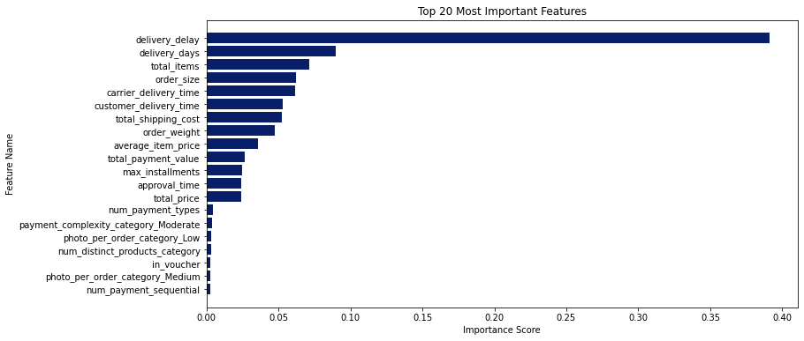
The analysis will prioritize the top features identified in this feature importance ranking, focusing on those with the highest impact on the target variable.

Slide 7
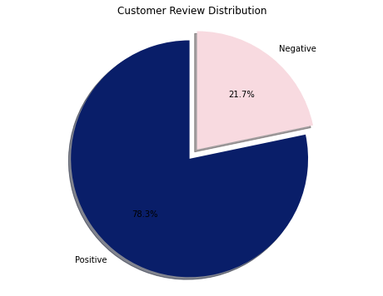
CUSTOMERS’ BEHAVIOR & TRENDS
78.3% of reviews are positive, indicating overall customer satisfaction.
However, 21.7% are negative, highlighting key areas for improvement.
Addressing these negative reviews is crucial for increasing customer loyalty and driving growth.

Slide 8
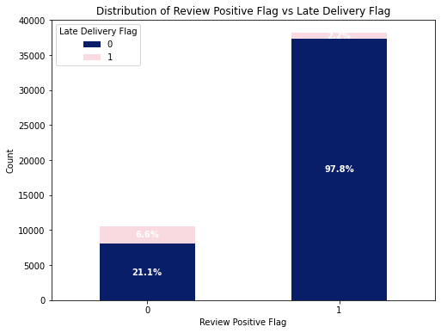
Delivery Impact on Customer Reviews
On-time delivery strongly correlates with positive reviews (97.8%).
Late deliveries significantly impact negative feedback (21.1% of negative reviews linked to late deliveries).
Prioritizing on-time delivery is crucial for improving customer satisfaction.

Slide 9
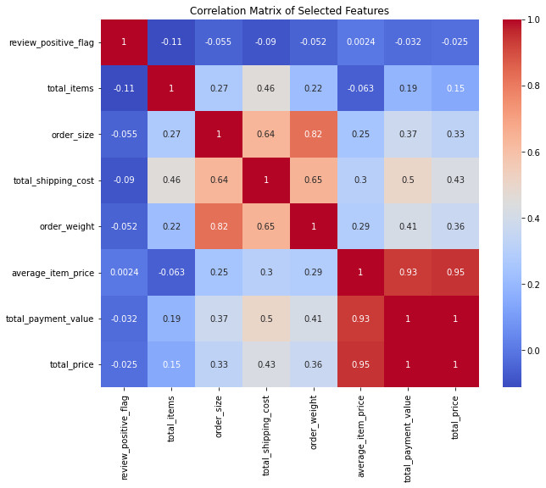
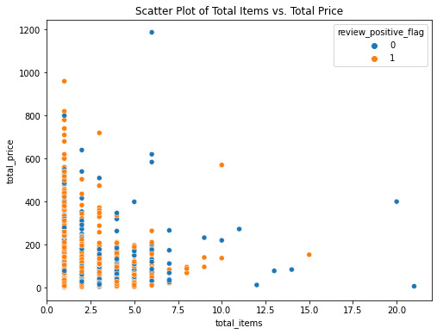
Weak negative correlations: total_items, order_size, total_shipping_cost, and order_weight show weak negative correlations with positive reviews. This suggests larger orders or higher shipping costs may be associated with slightly lower satisfaction
This scatter plot shows no strong correlation between total_items, total_price, and review_positive_flag. Both positive and negative reviews are scattered across the range of order sizes and prices.

Slide 10

Recommendations for Business Improvements
Prioritize On-Time Delivery: Invest in logistics and proactive communication.
Address Larger Order Issues: Review fulfillment and packaging for large orders.
Focus on High-Value Customers: Offer personalized service and premium options.
Further Analysis: Segment customers and analyze feedback for deeper insights.
Continuous Monitoring: Track metrics and adapt strategies for ongoing improvement.

Slide 11
TECHNICAL SECTION

Slide 12

FEATURE ENGINEERING
Order Features:
total_items
total_price
order_size
total_shipping_cost
order_weight
average_item_price
total_payment_value
total_discount_value
Customer and Review Features:
review_positive_flag
Delivery and Time Features:
approval_time
carrier_delivery_time
customer_delivery_time
delivery_delay
late_delivery_flag
delivery_days
Feature Engineering
*main target variable: review_positive_flag*

Slide 13
Logistic Regression
Random Forest
Gradient Boosting
AUC: 0.704
Accuracy: 0.8148
AUC: 0.693
Accuracy: 0.8165
AUC: 0.710
Accuracy: 0.8171
Logistic Regression shows a moderate AUC, indicating fair performance in distinguishing between classes. Its accuracy is quite high, suggesting that it generally performs well on the given dataset.
Random Forest performs similarly to Logistic Regression, with a slightly higher accuracy (0.17% better). However, its AUC is slightly lower, suggesting it might not be as effective at class separation compared to Logistic Regression.
Gradient Boosting has the highest AUC, indicating that it performs the best in terms of distinguishing between classes. It also has a slightly higher accuracy than the other models, making it the best model for this task.

Slide 14
Gradient Boosting
AUC: 0.710
Accuracy: 0.8171
 | label | 0.0 | 1.0
0 | 0.0 | 518 | 1628
1 | 1.0 | 140 | 7381
prediction | count
0.0 | 451
1.0 | 11978
The True Positive Ratio (TPR) is approximately 98.14%. This means that the model correctly identified 98.14% of the actual positive cases (1.0) in the dataset.
Prediction Breakdown:
Predicted 0.0: 451 cases
Predicted 1.0: 11,978 cases
This shows that the model is more likely to predict the positive class (1.0).

Slide 15
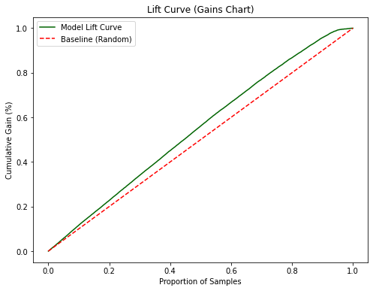
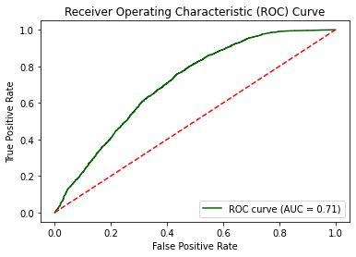
At 10% and 30% of the data, the model is 21.68% and 24.75% better than random guessing.
The model is 21.68% to 24.75% more effective than random guessing in the early thresholds of the data.
The ROC curve shows the tradeoff between True Positive Rate and False Positive Rate at different classification thresholds.
AUC of 0.71 indicates that the model has good discriminatory power, with a better-than-random ability to distinguish between the positive and negative classes.

Slide 16

RECOMMENDATIONS
Focus on Gradient Boosting for Optimal Results:
The Gradient Boosting model has the highest AUC (0.710) and accuracy (81.71%), making it the best-performing model for predicting key business outcomes
This model can help proactively address delivery delays and optimize customer experience by identifying high-priority cases
Leverage Predictive Insights for Operational Efficiency:
The model's ability to predict late deliveries with good accuracy means that the business can anticipate delays and take preventive actions (e.g., improve logistics, inform customers in advance).
Targeted Interventions Using Model Predictions:
Use the model's predictions to prioritize high-risk orders, allowing the business to focus resources where they will have the most impact.
This can lead to cost savings and more efficient use of resources

Slide 17

THANK YOU

Slide 18
REFERENCE
Importance of Delivery Time in Customer Satisfaction & Reviews
Article: Xu, X., & Li, Y. (2023). The impact of delivery speed on customer satisfaction in e-commerce: Evidence from online reviews. Journal of Business Research, 156, 113463.

